Slide 1
Attack on Smart grid system

Slide 2
Kind of attacks

Slide 3
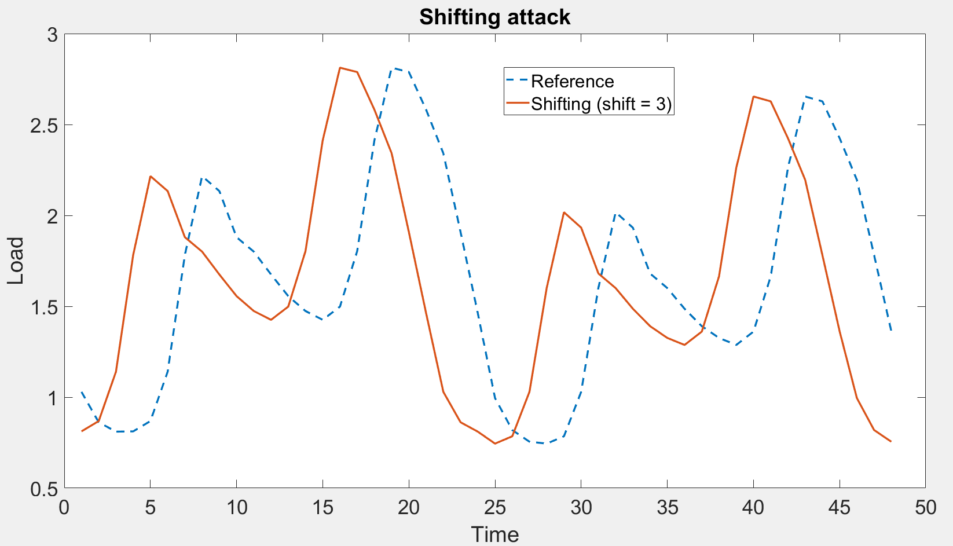
shifting

Slide 4
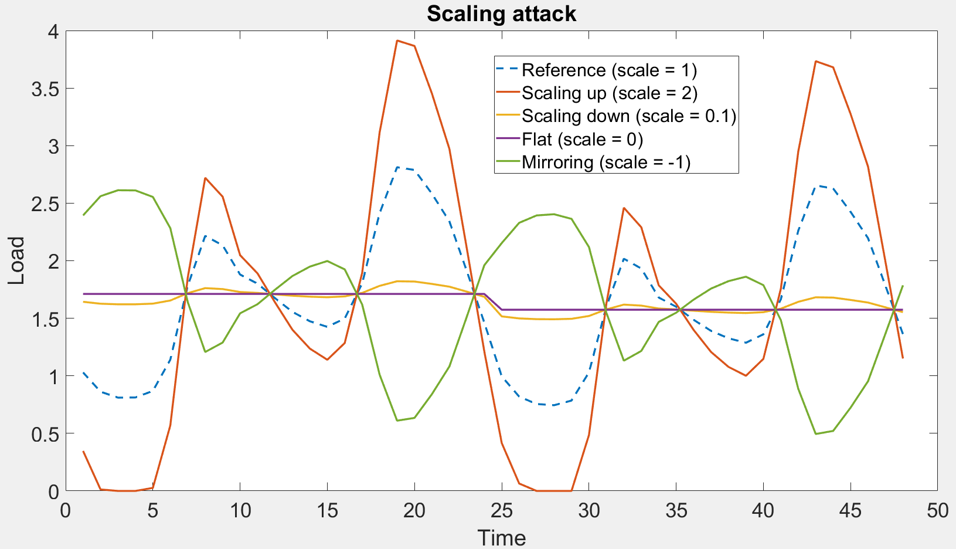
Scaling

Slide 5
Weak attacker
Only the attacker’s forecast is changed

Slide 6
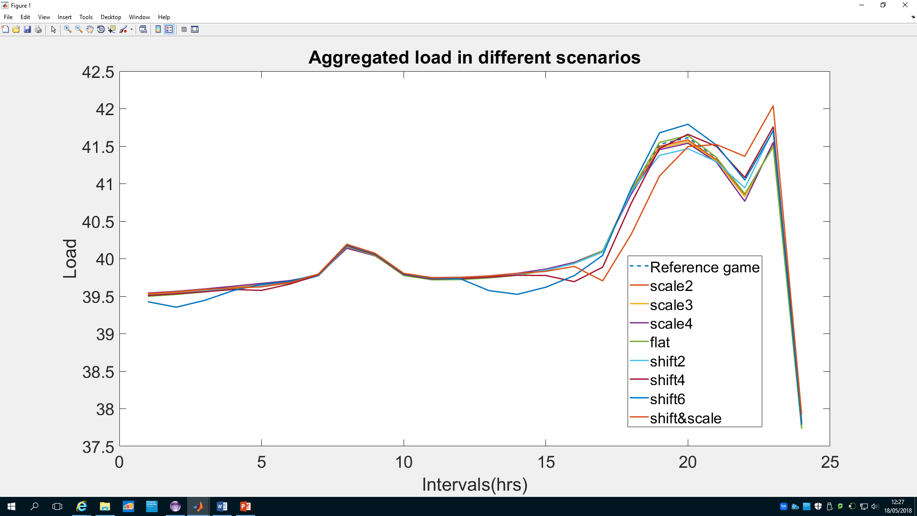
Load changes

Slide 7
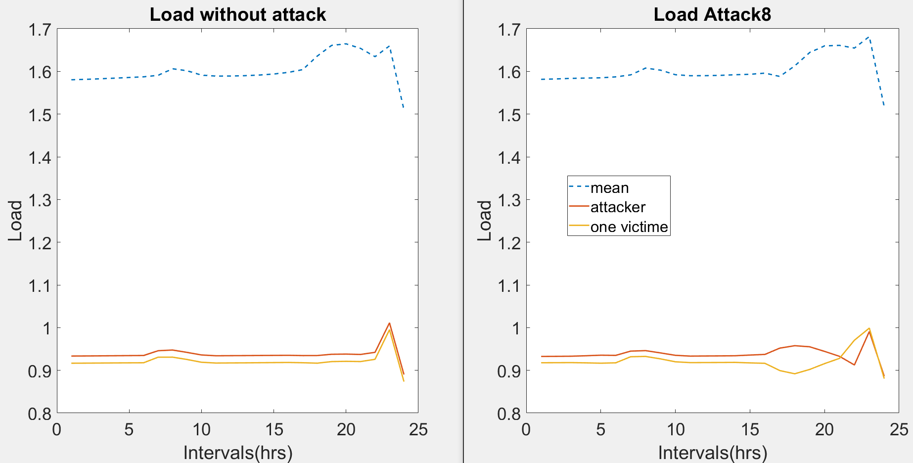
Difference

Slide 8
strong attacker
All the forecasts are changed

Slide 9
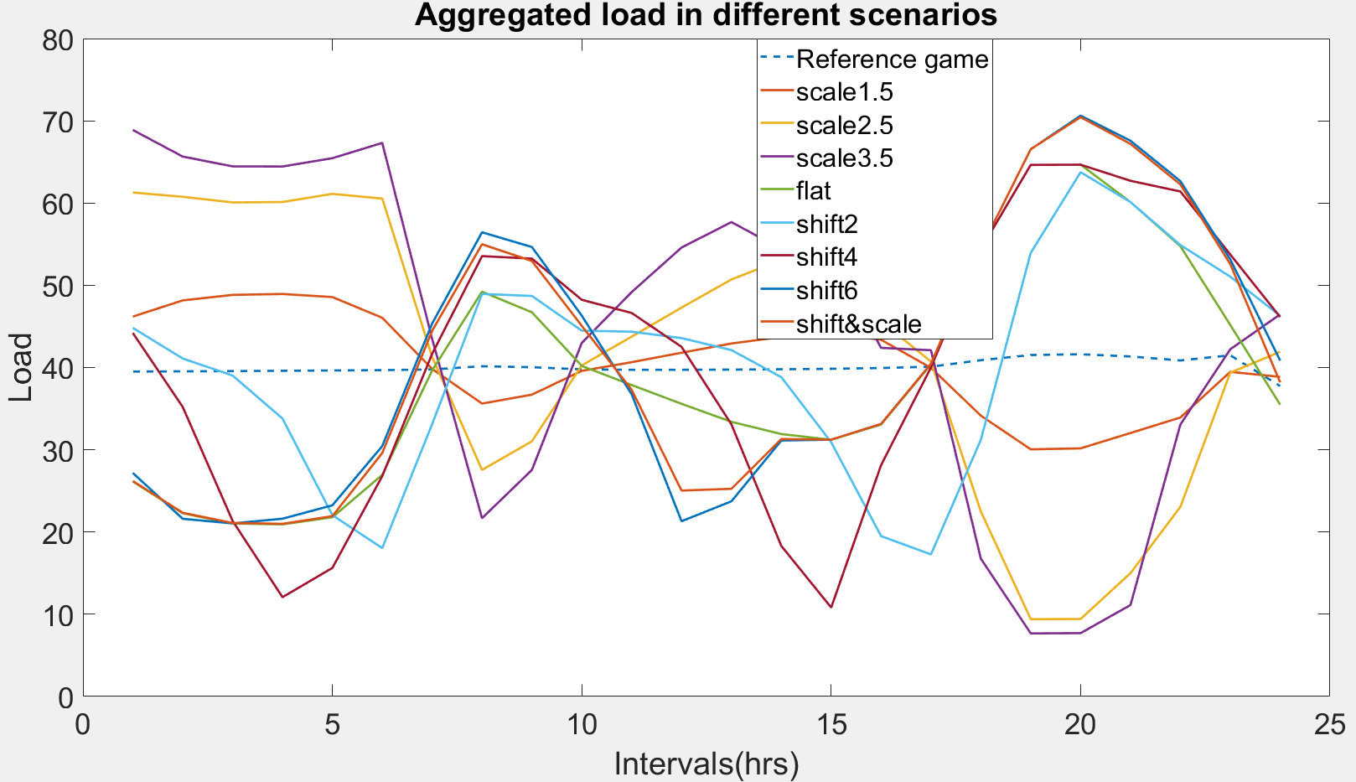
Load changes

Slide 10
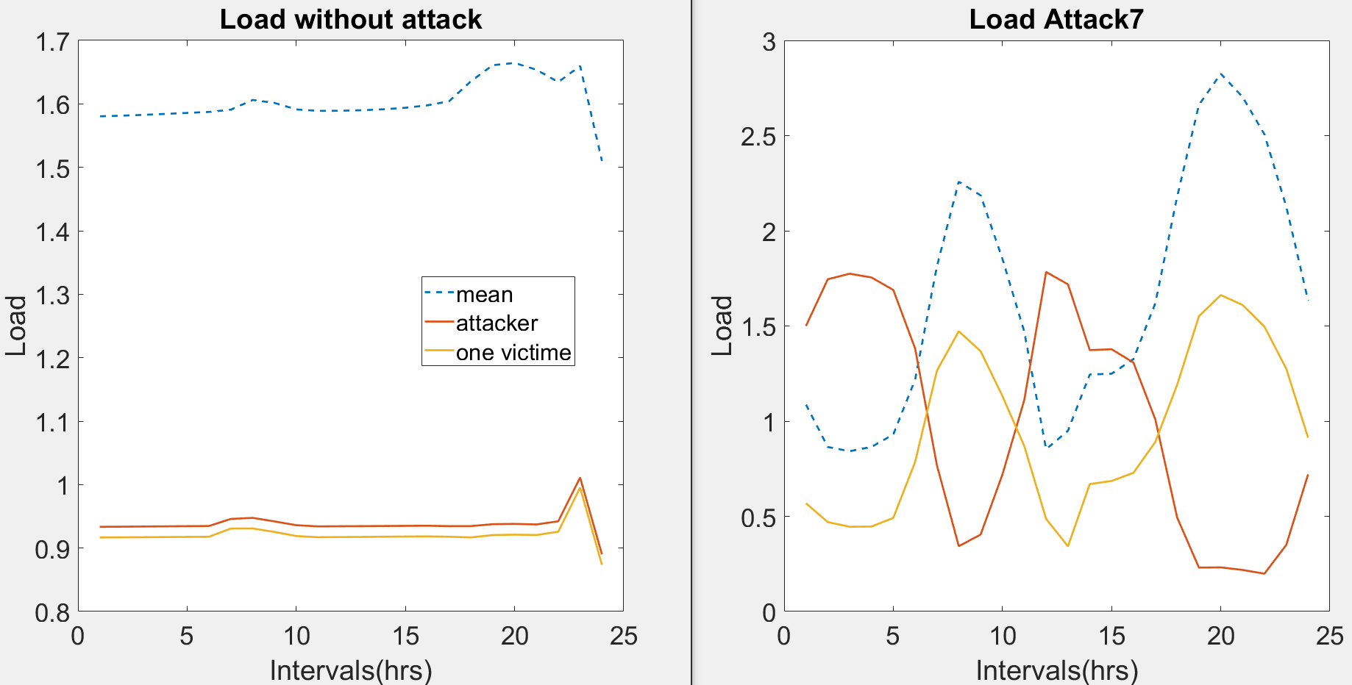
Difference

Slide 11
results

Slide 12
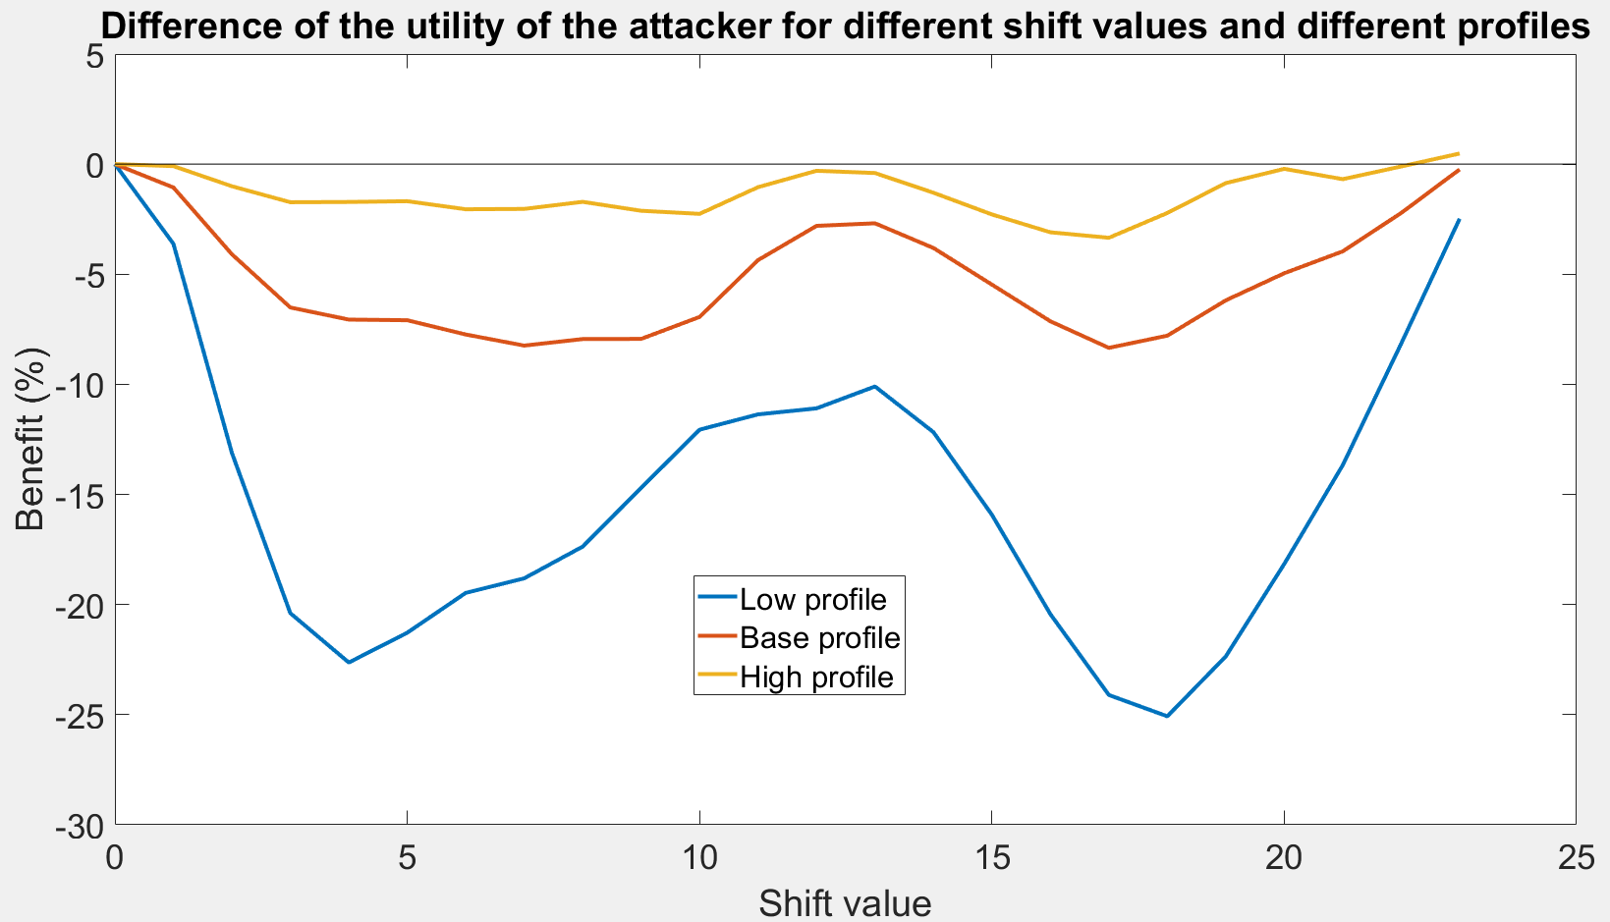
shifting attack

Slide 13
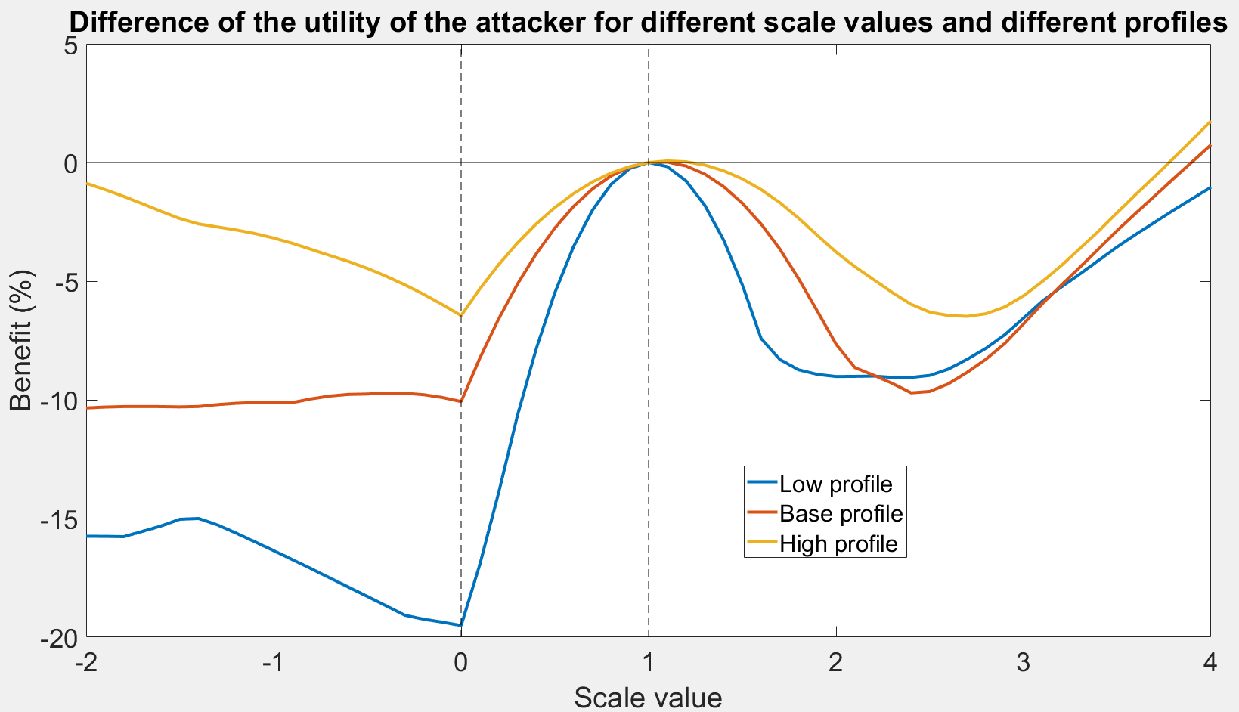
scaling attack

Slide 14
Forecast
Add errors using a normal law

Slide 15
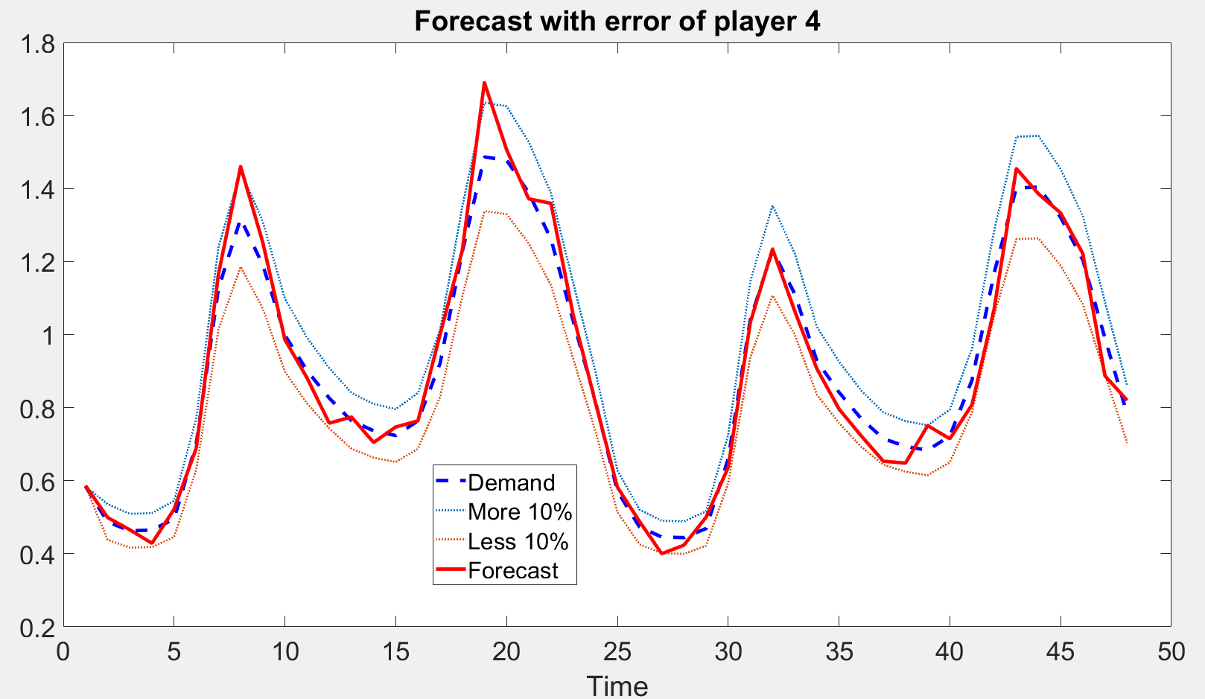
 = 5 error 3%

Slide 16
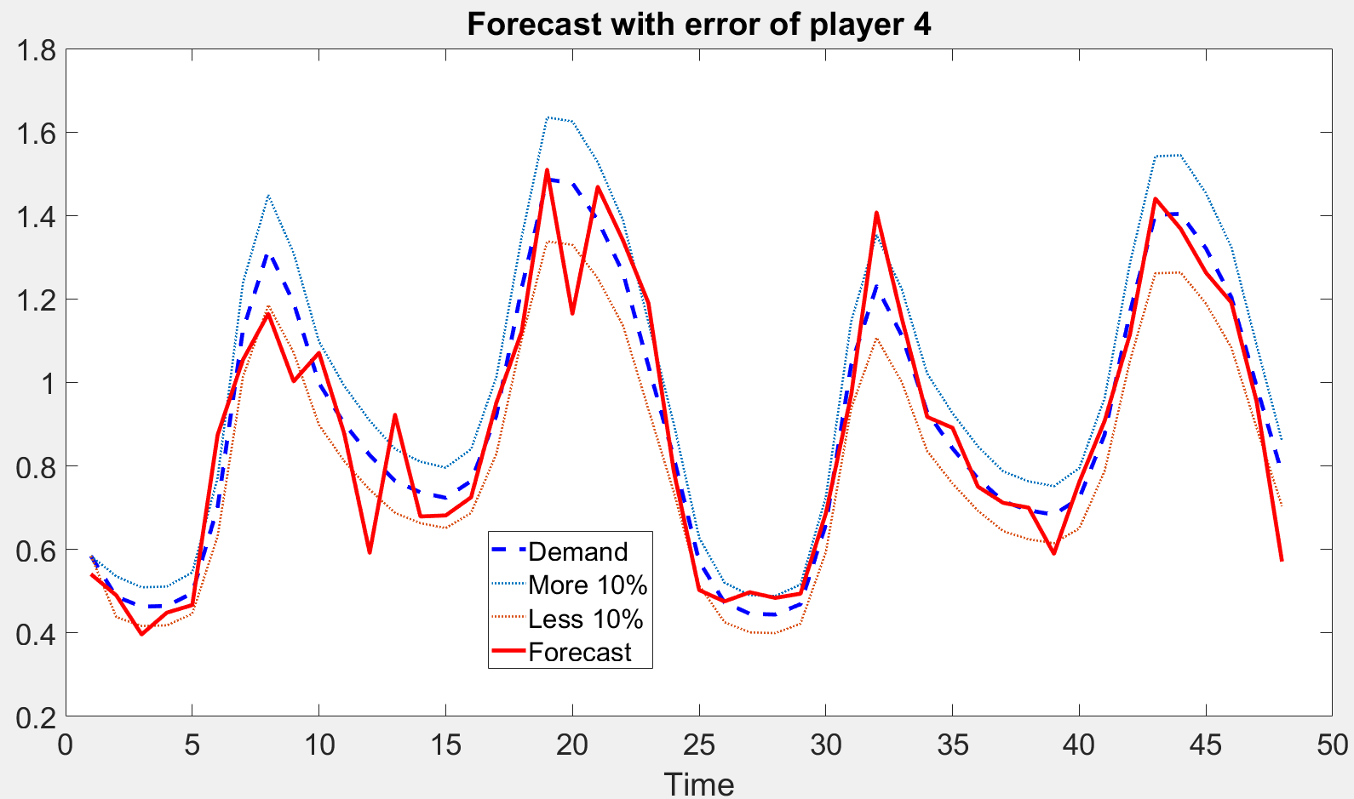
 = 10 error 7.9%

Slide 17
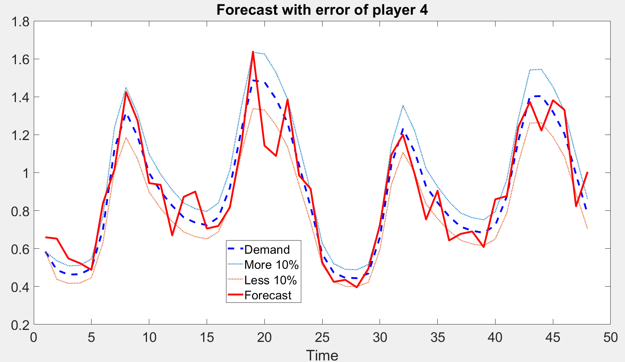
 = 12 error 10.8%

Slide 18
problem

